Slide 1

Mobile Application and Cloud Computing
Sapienza University, Rome
2019-2020
Nicola Di Santo, Matteo Rizza

Slide 2
App Goal
Proof of concept of a basic search engine specific for recipes.

Slide 3
Main Features
Authenticate to use THE APP
Search recipes by ingredient
Save locally ALL YOURS favorite recipes
Add ingredient you do not have into a shopping list
Find markets near to you

Slide 4
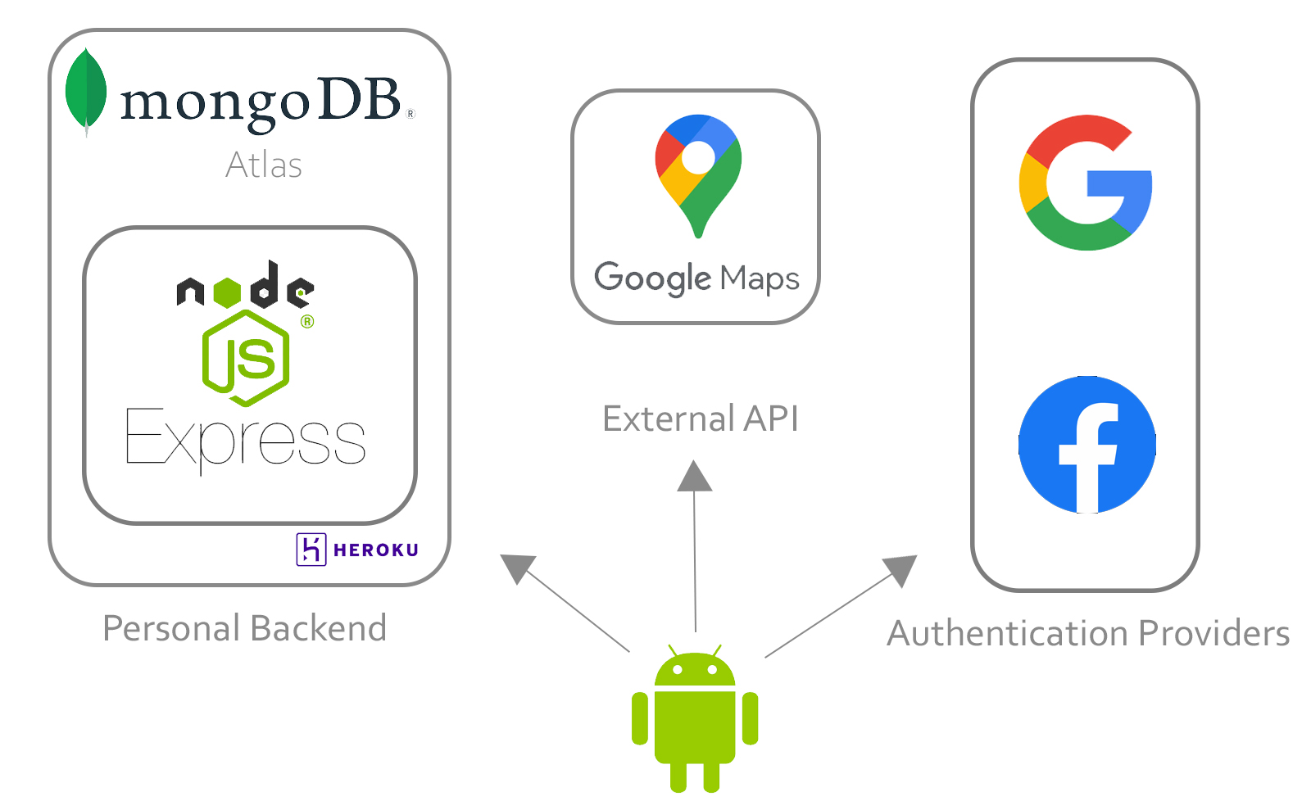
High Level Components

Slide 5
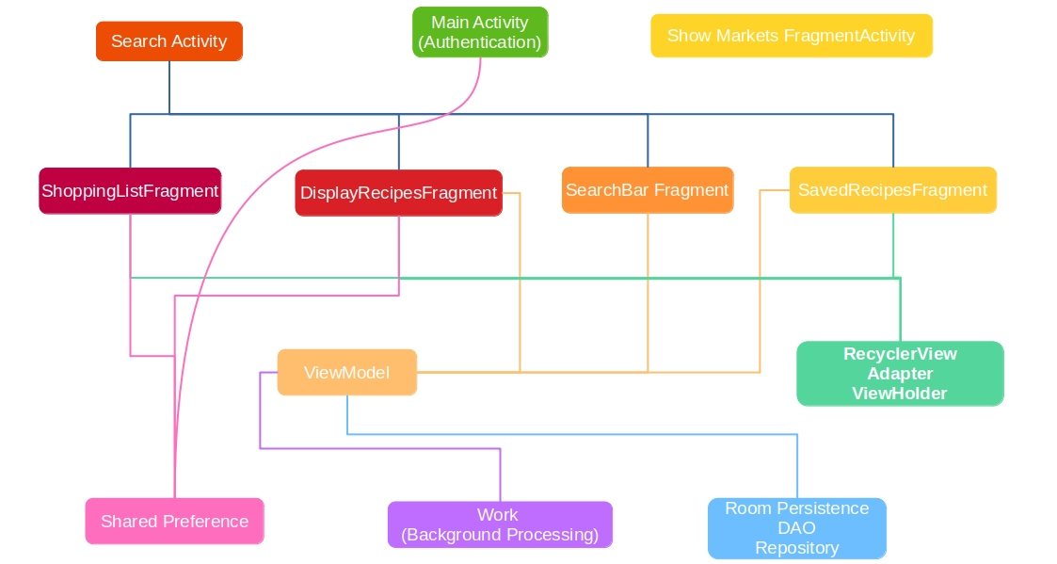
Android Architecure Components

Slide 6
App Data
We use real recipes data obtained with web scraping from giallozafferano.it
The scraper runs in our NodeJs backend
The scraper writes acquired data directly into an Atlas Collection
The app query those data using the API
Search by ingredients is implemented using a Text Index defined on the recipes` ingredient field

Slide 7
Thank You For The Attention
Rizza Matteo: https://www.linkedin.com/in/matteo-rizza/
Di Santo Nicola: https://www.linkedin.com/in/nicola-di-santo-b98647192/

